Slide 1


New VIMMI Webpage Prototype
Francisco Maria Calisto

Slide 2

Francisco Maria Calisto (Trainee)
Information Systems and Computer Engineering
Instituto Superior Técnico
Universidade de Lisboa
Visualization and Multimodal Interfaces
@ INESC-ID Lisboa
http://franciscocalisto.me/
francisco.mcalisto@gmail.com

Slide 3

Why WordPress?

Slide 4

Testing Prototype URL:
http://nvwp.franciscocalisto.me/wordpress

Slide 5

Responsive!

Slide 6


Slide 7
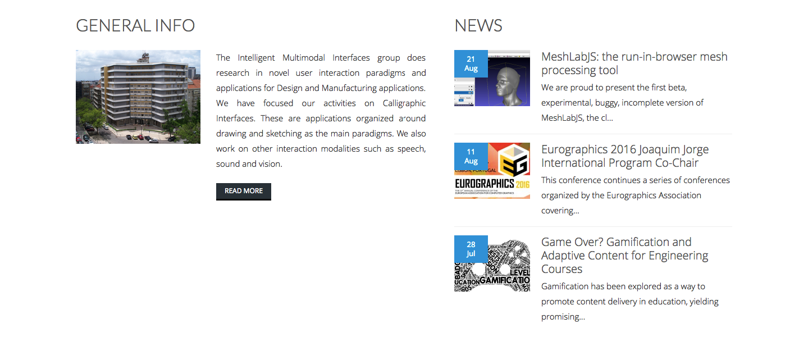

Slide 8


Slide 9
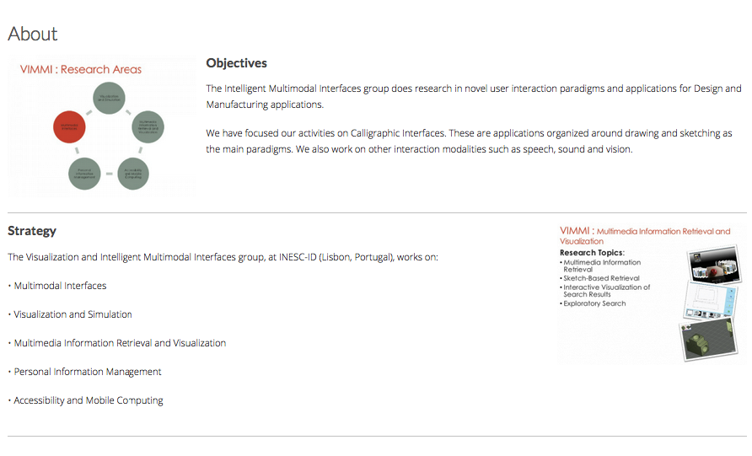

Slide 10
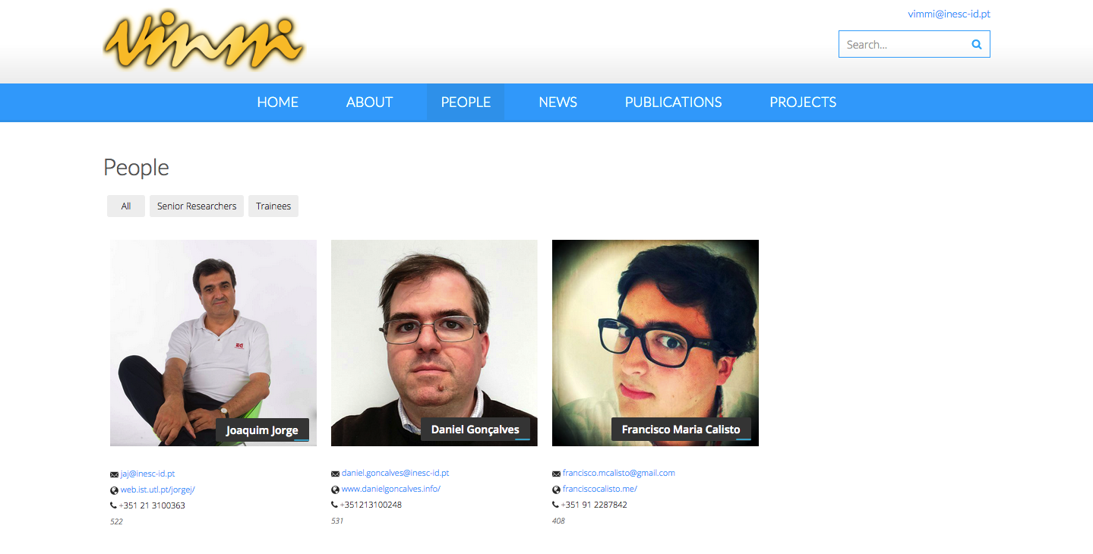

Slide 11
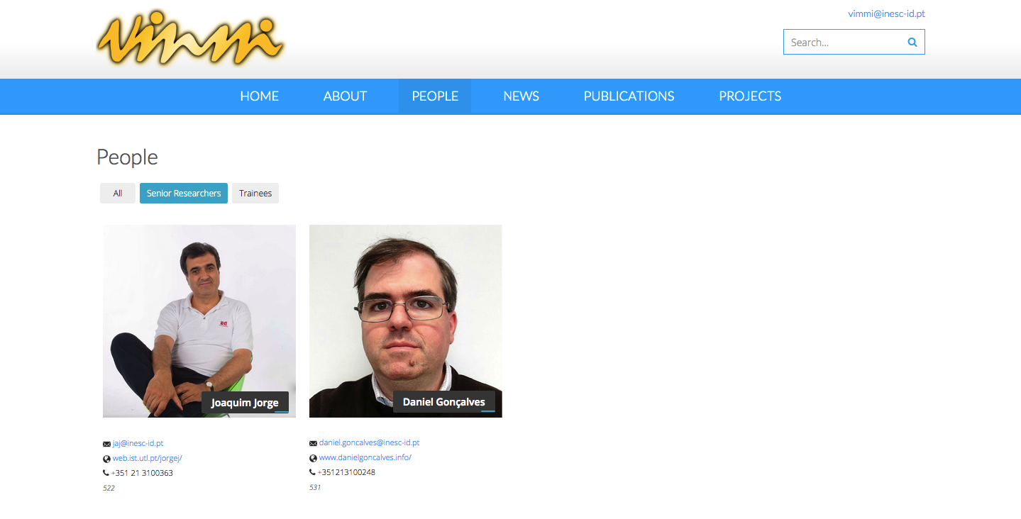

Slide 12
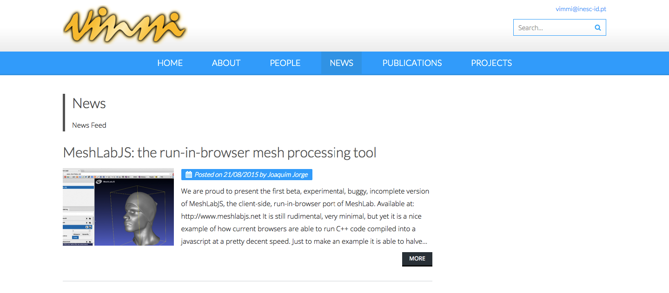

Slide 13
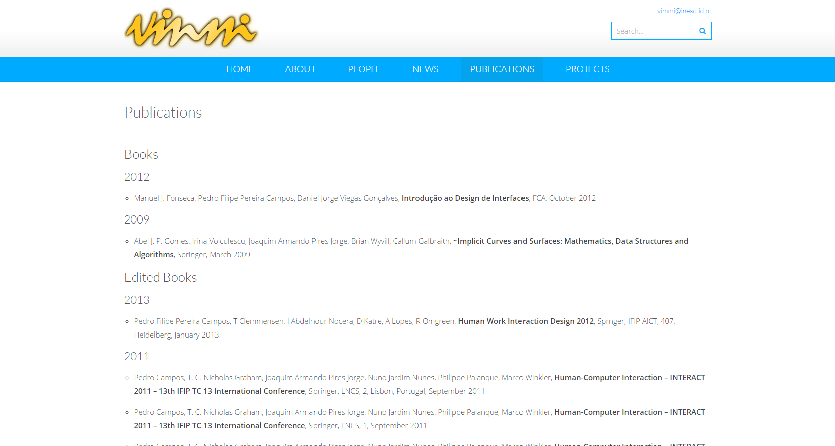

Slide 14
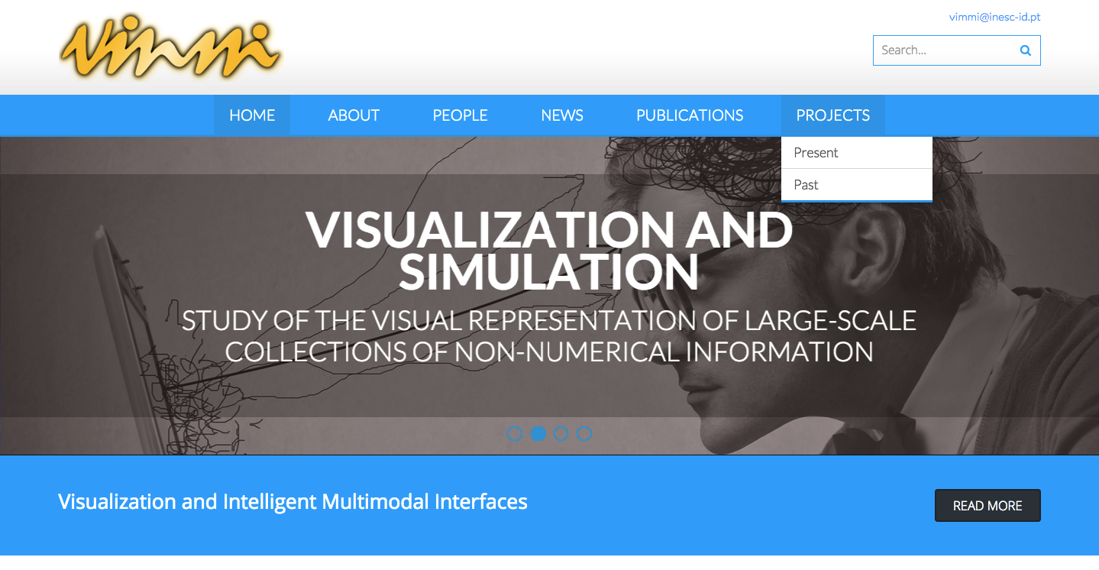

Slide 15
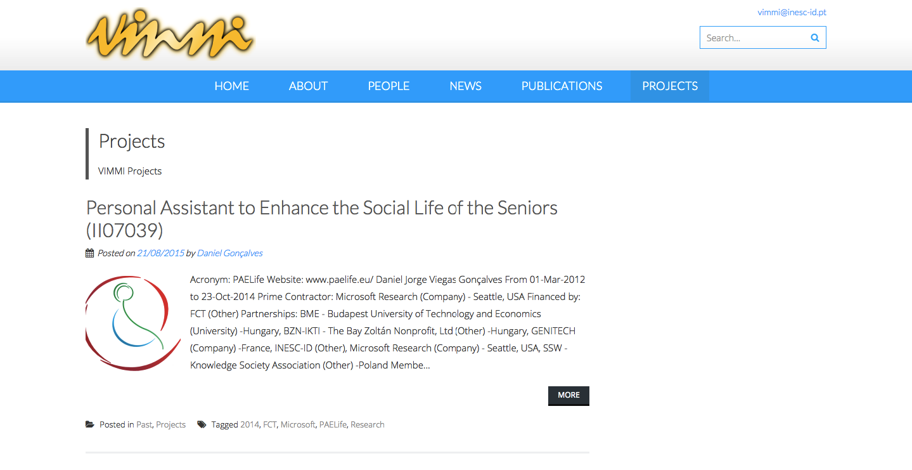
Author

Slide 16
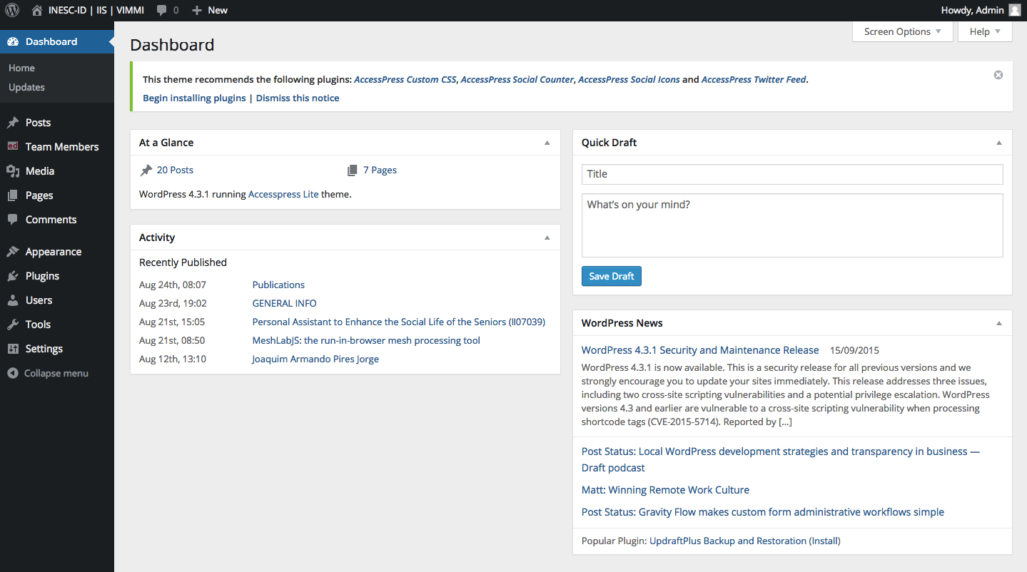
Administration Page URL:
http://nvwp.franciscocalisto.me/wordpress/wp-admin/

Slide 17
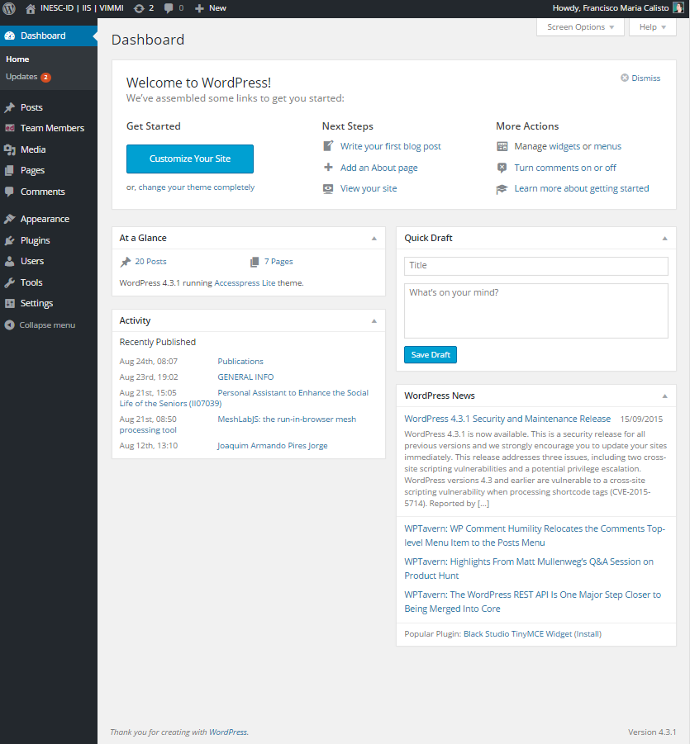
Back office

Slide 18
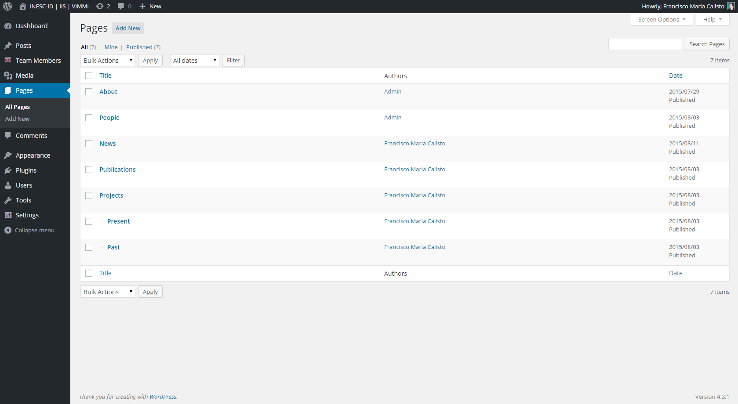

Slide 19
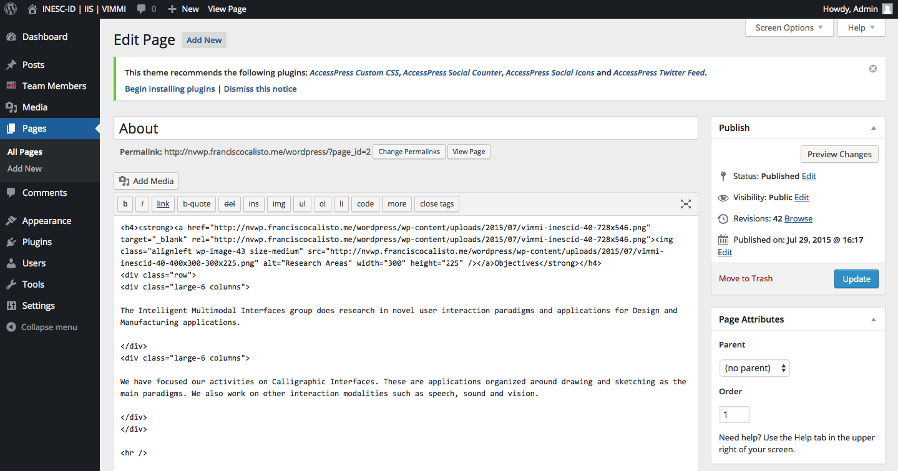

Slide 20
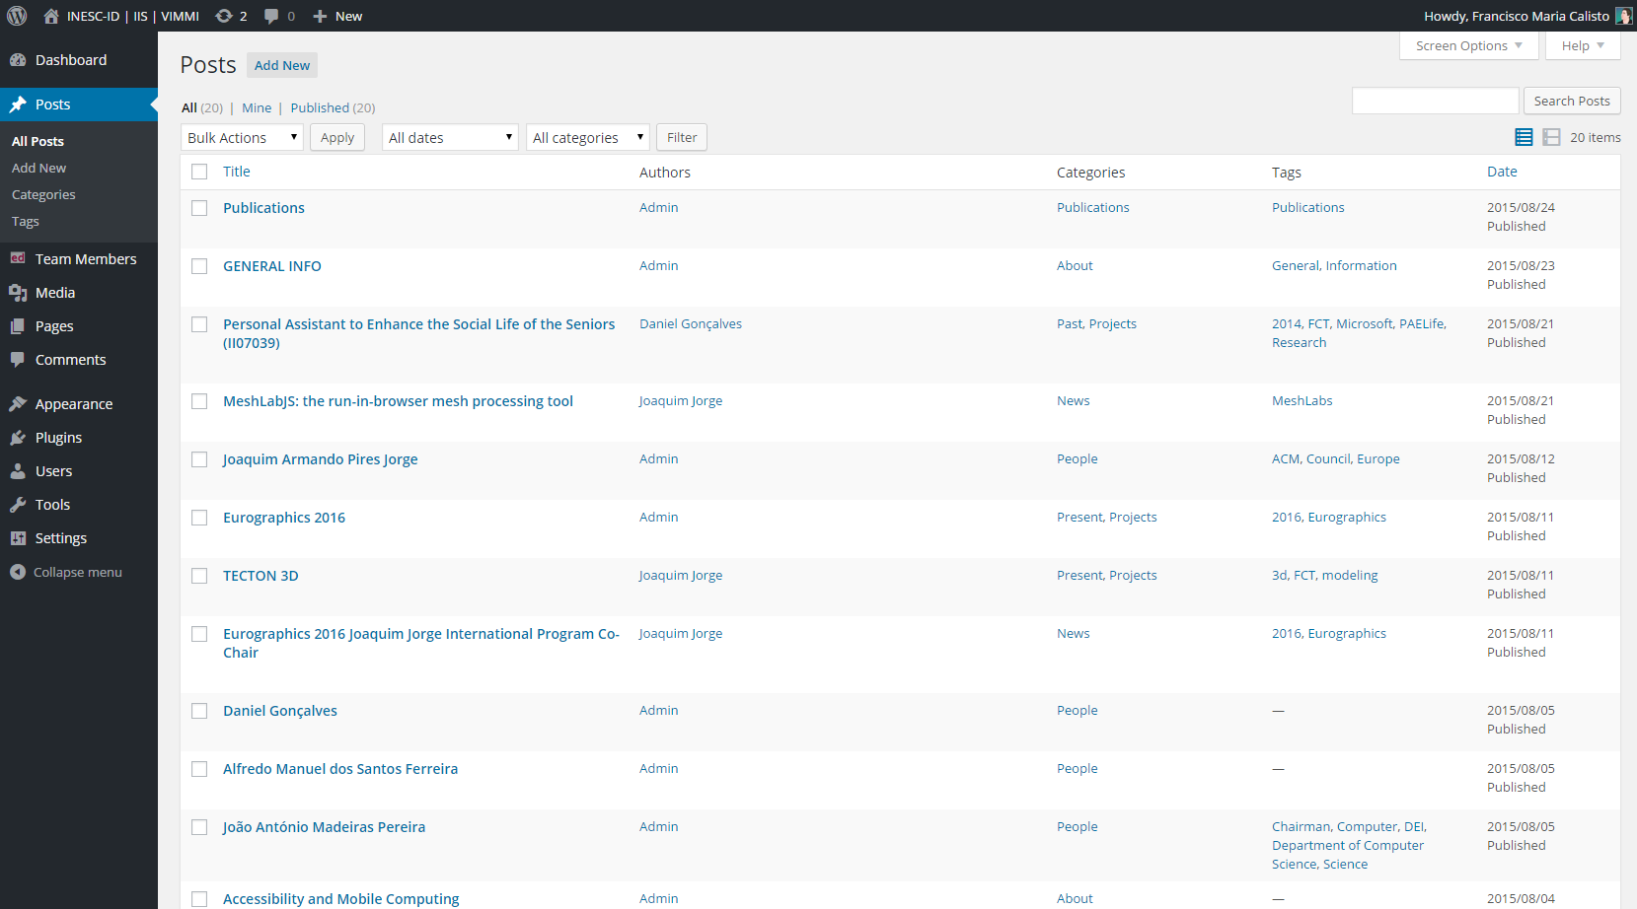

Slide 21
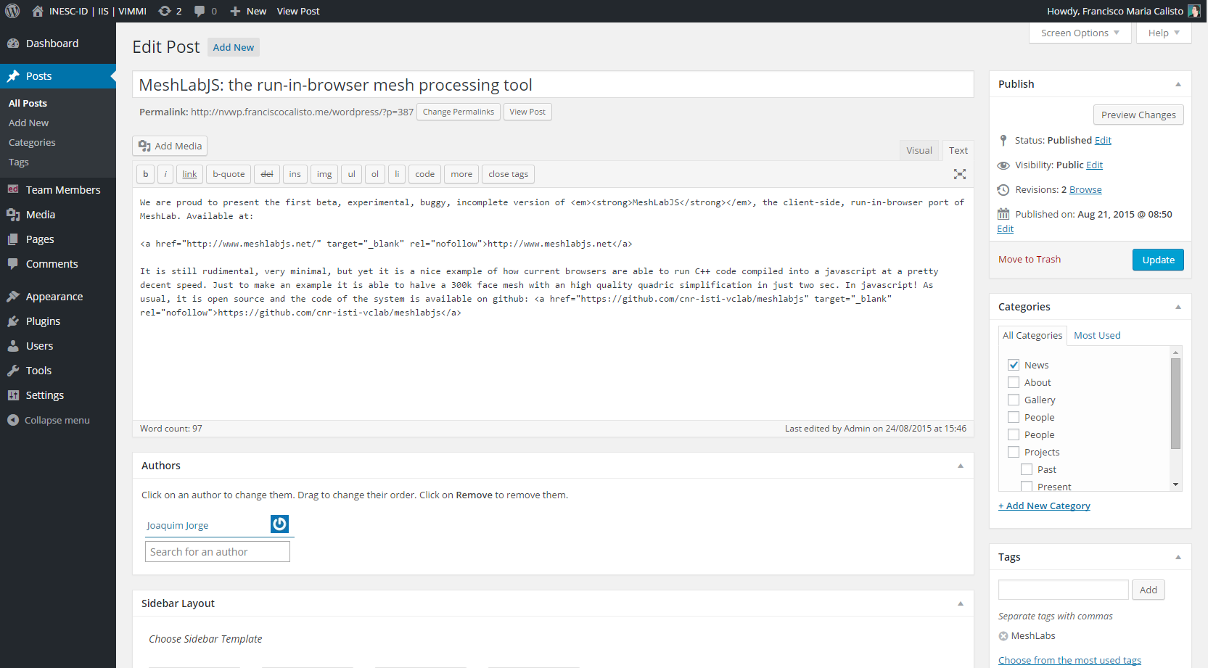

Slide 22

Documentation?
GitHub Pages

Slide 23
Thank you!

